Slide 1

Family Action
Norfolk & Waveney Autism/ADHD Support Service (NWAASS)
East Team- Laura, Sarah, Beckie
Notes:
Just to demonstrate the
Office based in Gorleston Library

Slide 2
Who we are…
National Charity
Commissioned by Norfolk & Waveney Integrated Care Board
Office based in Gorleston Library
Notes:
Who we are
Family Action transforms lives by providing practical, emotional and financial support to those who are experiencing poverty, disadvantage and social isolation across the country.
We have been building stronger families since 1869, and today work with over 60,000 families through our 200 community-based services. Thousands more are supported with financial assistance through education and welfare grants programmes.
Our innovative services reach out to those in need, we strengthen families and communities, build skills and resilience and improve the life chances of children and adults.
In Norfolk and Waveney, we have already achieved a lot by working in partnership; this has been strengthened through our response to the COVID-19 pandemic. These changes have been made possible by different organisations – NHS hospitals, GPs, mental health and community health services, local councils, care homes and social workers, voluntary and community organisations and others – joining forces to agree and plan for local people’s needs.

Slide 3
What we do….
Referrals from the Newberry Child Development Centre
Support groups (Gorleston & Lowestoft)
Monthly Newsletter -Closed Facebook Group
Pre and post diagnostic courses for parents and carers
Virtual workshops on particular issues such as sleep, eating, social stories, anxiety, school issues, behaviour etc.
Sign-posting and one-to-one support

Slide 4
https://www.autismeducationtrust.org.uk/celebrating-autistic-strengths-and-differences https://www.autismeducationtrust.org.uk/celebrating-autistic-strengths-and-differences

Slide 5
Plan Bee Course
Understanding and supporting your child or young person with additional needs’
A FREE 3 week course (2hrs per week) written by two Clinical Psychologists working in Norfolk and is aimed at parents or carers of children or young people with additional needs including suspected or diagnosed ASD or ADHD.
Behaviour as communication
Understanding the full range of needs your child may have
Developing a plan to support behaviour in difficult situations
Strategies for creating an environment in which your child can thrive
Sharing experiences, challenges and successes with other parents

Slide 6
Cygnet Course
Created by Barnardo’s – The Cygnet programme is delivered over six, three-hour sessions which include:
Autism an overview
Sensory needs
Communication
Understanding behaviour
Supporting behaviour
Choice decided by parents/carers
The programme has been developed by acknowledging parents as the experts on their own children/young people. No one knows your child/young person as well as you do, yet becoming a parent does not come with any instant qualification or training pack.

Slide 7
Testimonial:
“I know at the beginning of the course I wasn’t very positive and thought its wasn’t going to make a difference but it has, massively. I can now see a light at the end of the tunnel and feel so much more confident in dealing with ‘my son’. You have helped our family so much!”

Slide 8
Dr Stephen Shore, an autism advocate who is on the spectrum, said,
"If you've met one person with autism, you've met one person with autism."

Slide 9
Common Difficulties…
Executive Functioning
Sensory processing Co-occurring associated conditions!!
Social interaction
Social Communication
Repetitive & rigid behaviours
Remember those strengths too!!

Slide 10
Strategies
-Give your child time to process- 12 seconds!
-Help them to ‘empty their bucket’
-Use social stories
-Visual aids/timetables
-Now and Next
-Apps, Timers
-Scripts
-natural consequences
- Ear defenders
- Fidget Toys
- Quiet spaces/breaks
Time for their special interest
Sleep routine
Short, clear, instructions (Name, instruction, Thank you)
Diary to look for triggers
Modelling strategies- taking time out
Notes:
i Create… Social Skills Stories is an app for young children and individuals with developmental delays. It has a social story sample that serves as a guide. You can organize photos and pages in the book. This app helps them recall steps of a storyline and enhance their ability to improve their social skills and adapt it as a routine. This app also has a child lock feature that protects the deletion of data.
This app helps children with autism learn more life skills. It helps develop areas such as sharing, trying new foods and working with emotions. Designed for parents and caregivers of kids with ASD

Slide 11
Local & Online Support
SENsational Families
Just One Norfolk website-
SEND Local Offer- publication of all provision across education, health & social care
SENDIASS- provide free and impartial information, advice and support (EHCP’s, understanding letters/reports, policies and legislation)
IPSEA- free and independent legally based information to help get the right education for children with SEND
Notes:
The shape of this image matches the holding and thank you slides for consistency.

Slide 12
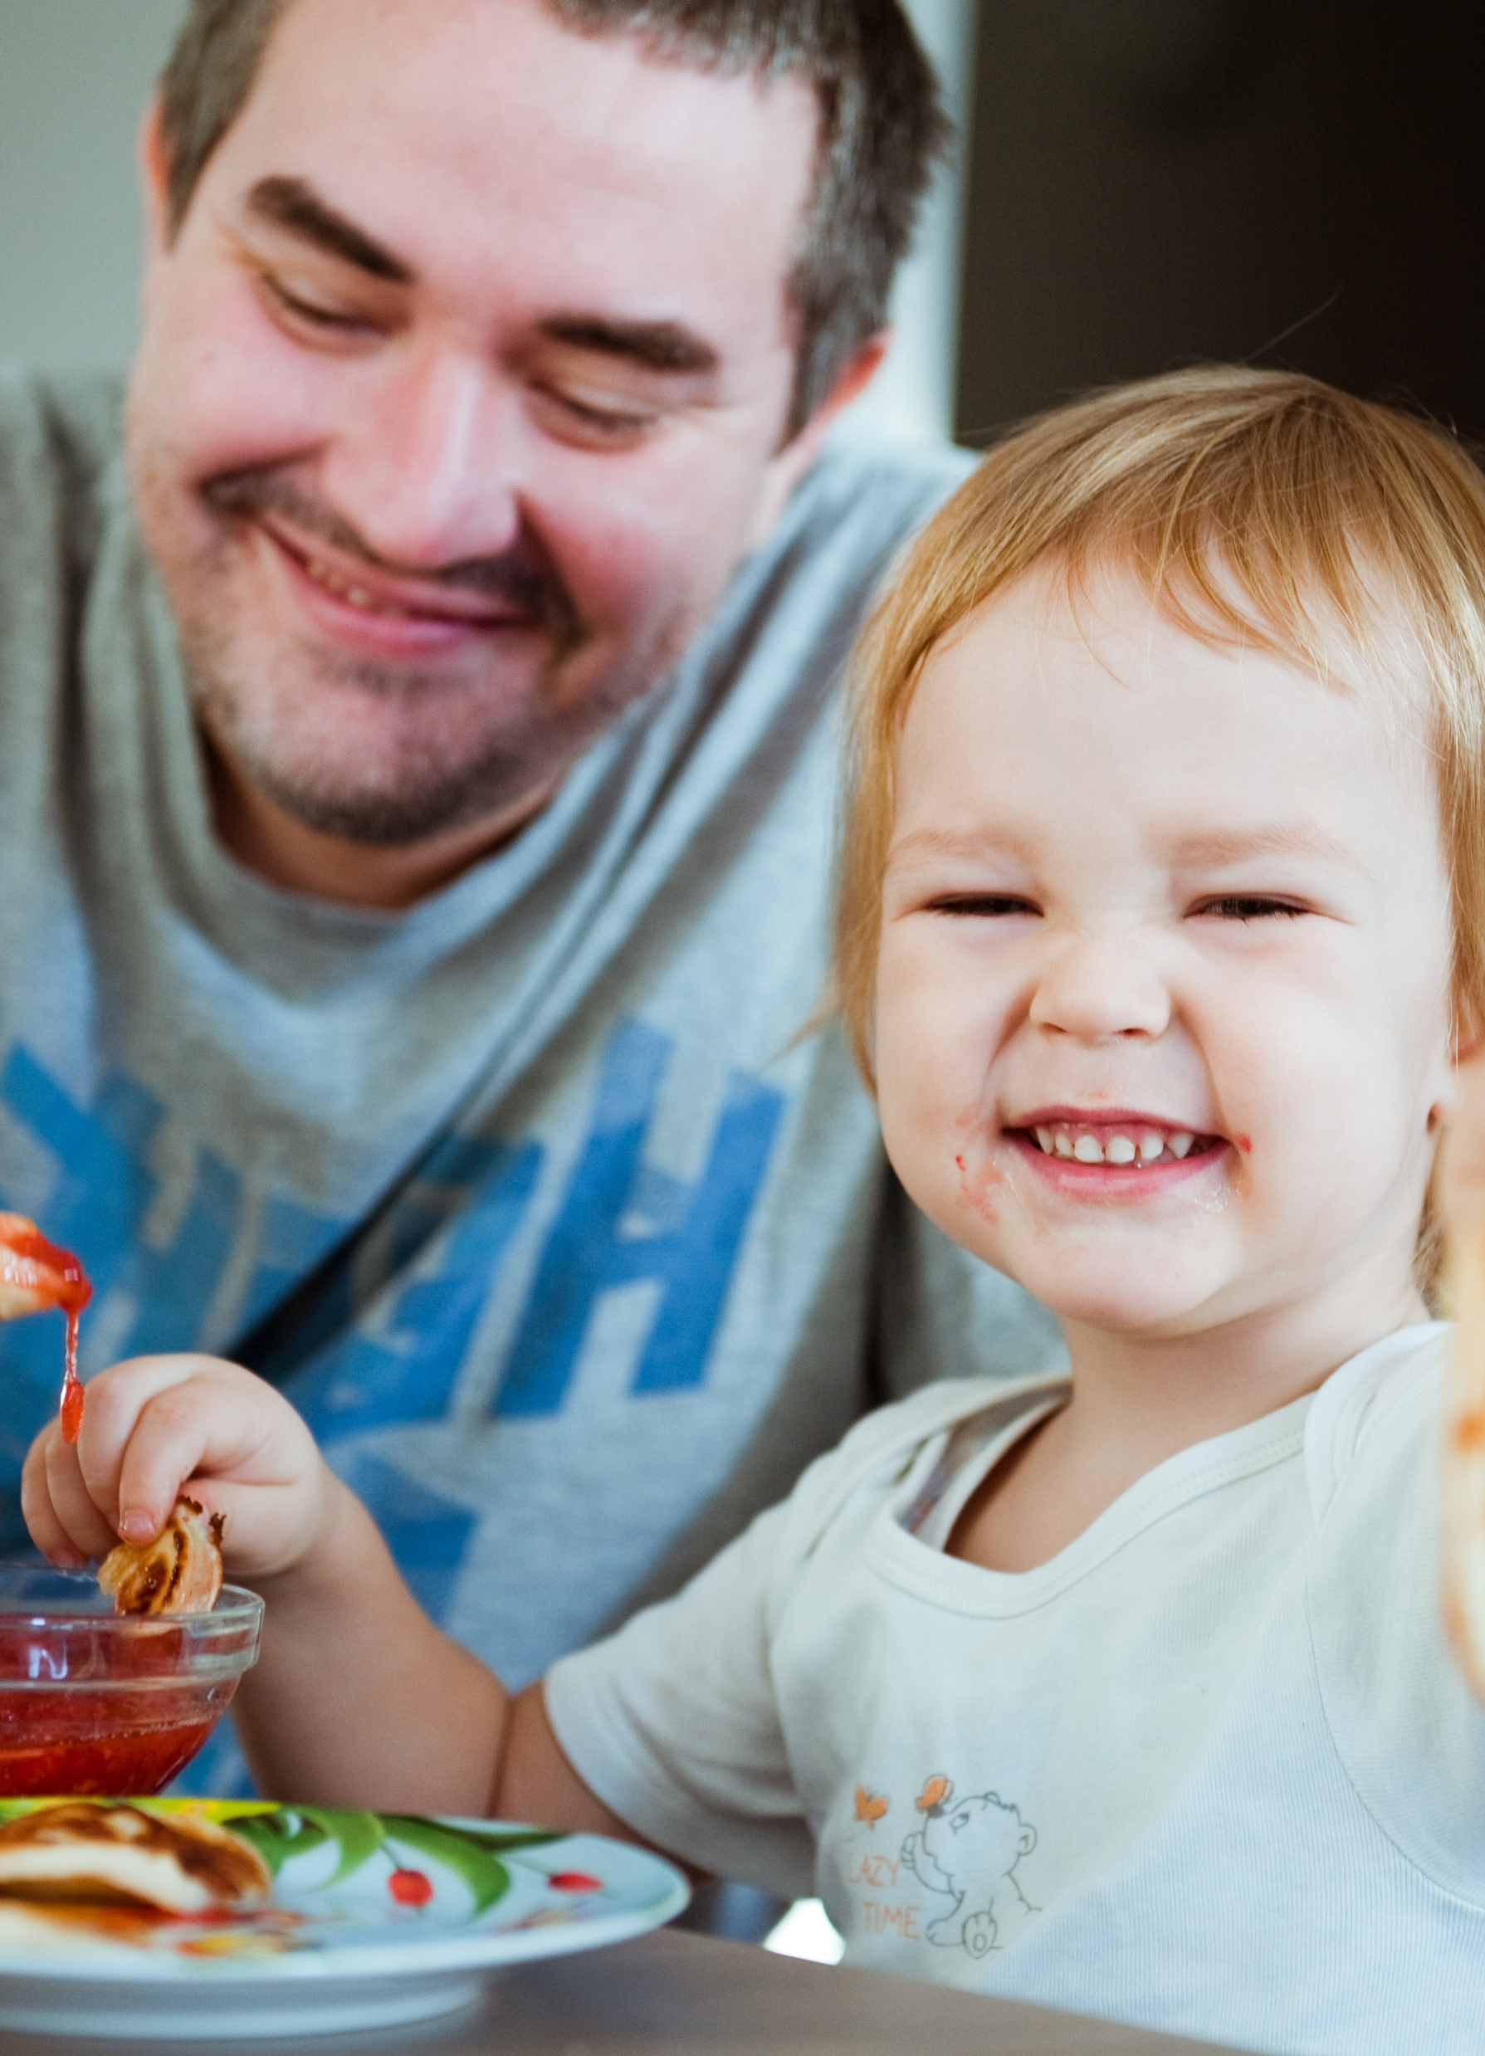
Thank you

